Slide 1
Previews and Workflow/ Lifecycle of Electronic Resources
Frank J. Bove
Associate Professor of Bibliography and Electronic Resources Librarian
The University of Akron

Slide 2
ERM – ERMI – ERAMS – etc.
E - electronic
R - resource
A - access
M - management
S - systems

Slide 3
The Cycle
Acquire =>
Access =>
Administrate/Manage (troubleshooting) =>
Evaluate =>

Slide 4
Acquire
Identify/Explore A Possible Need
Preview/Trial
Licensing
Subscribe
Purchase

Slide 5
Access
ACCESS
Authentication
IP vs. Login
Remote – Proxy &/or VPN
MARC
OpenURL (Olinks, etc.)
Holdings/Coverage management (SerialsSolutions 360 Core, Ebsco A to Z, etc.)

Slide 6
Administrate/Manage
Annual, Monthly, Daily or “routine” maintenance
Renewals
URL changes
Ticklers
Troubleshooting
Access Issues (local/remote)
Holdings (“What do/should we have access to….?)

Slide 7
Evaluate
Was it worth it?
In terms of investment:
Fiscal resources – cost per use
Personnel
Use
Statistics
COUNTER
SUSHI
Will it be worth it again?

Slide 8
Like We Didn’t Know…
Survey says…Disproportionate distribution of funds allocated to e-resources vs. allocation of personnel devoted to maintain e-resources
More and more spent on e-resources
Print material mostly up-front investment
E-Resources require ongoing maintenance
Need more ER personnel!! (new hires – cross-training, etc.)

Slide 9
Our Shop at UAkron
Current Reorganization of UL Departments
Electronic Services Department
Electronic Resources Unit (one librarian)
ERM (one staff – Rock Star #1)
UL Website (one staff – Rock Star #2)
Cataloging Unit
Systems Unit

Slide 10
Working in Gray Areas via Collaboration
Collection Management
Subject Librarians
Acquisitions
Ordering/Purchasing
Licensing
Electronic Services
Information Technology Services

Slide 11
Our Basic Workflow Paths
Trunk #1 – With Preview/Trial
Trunk #2 – Without Preview/Trial

Slide 12
Trial database information

Slide 13
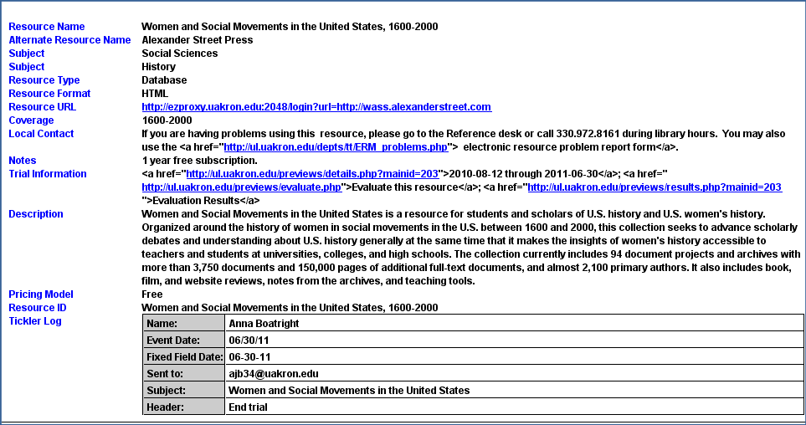
Trial Link – HTML In Staff Mode

Slide 14
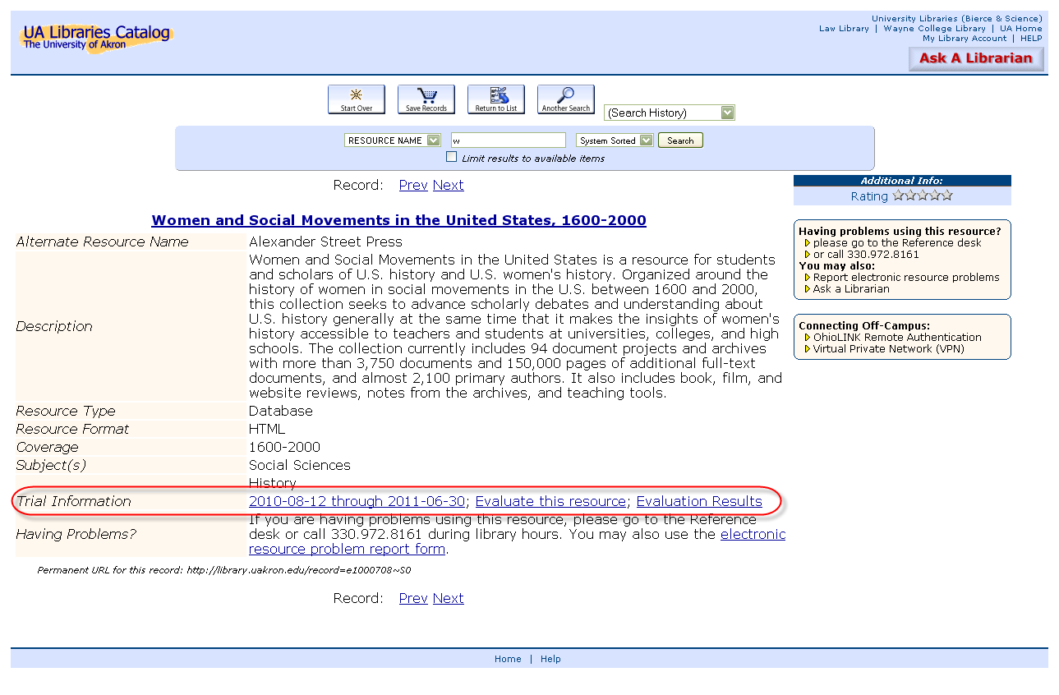
Trial Link in Resource Record

Slide 15
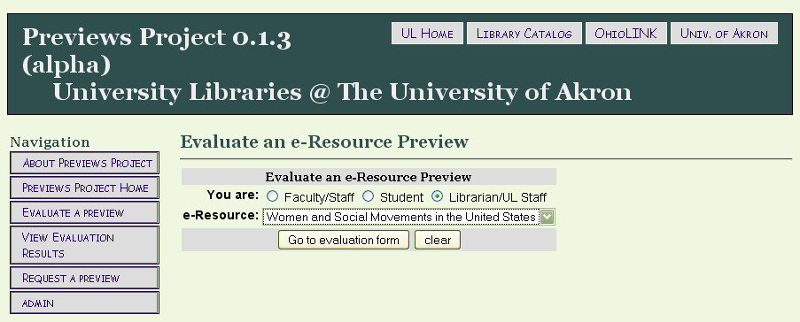
Evaluation form for faculty, students, & librarians

Slide 16
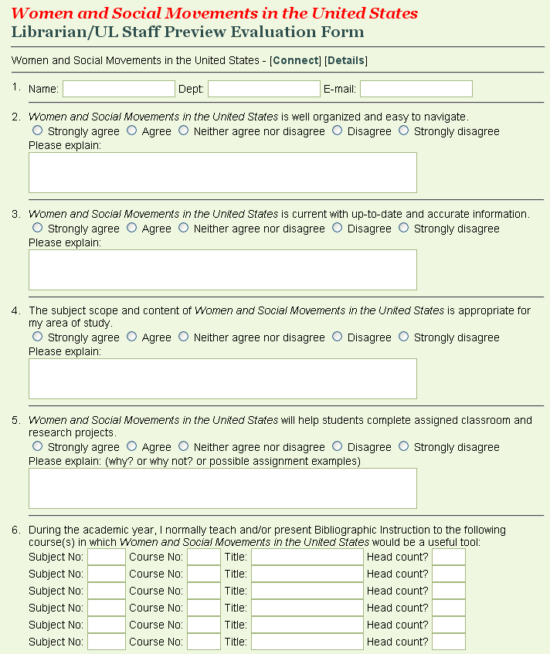

Slide 17
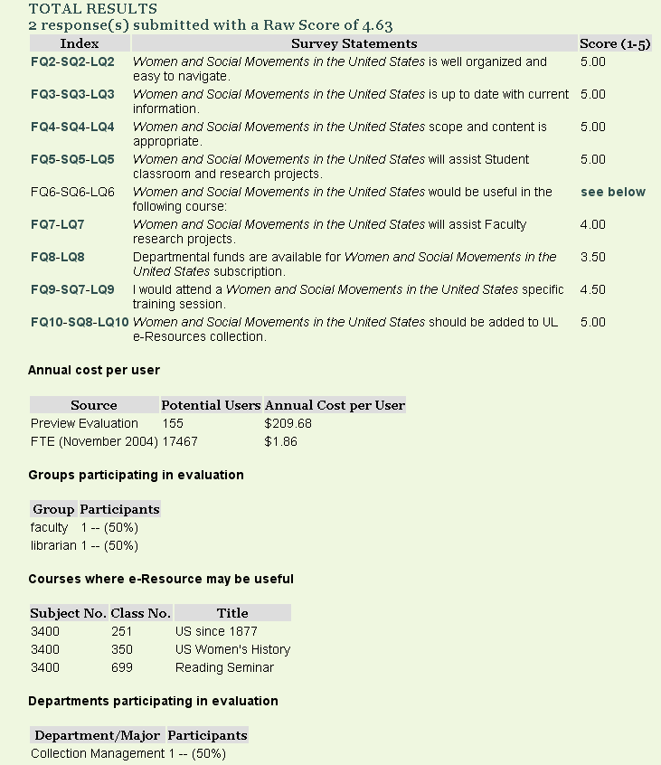

Slide 18
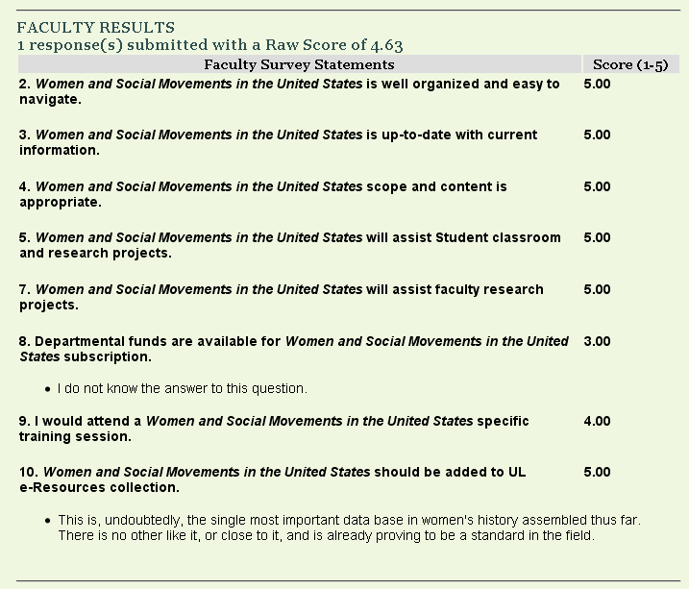

Slide 19
Questions &/or Discussion
Thank you!

