Slide 2
(Your School Name or Logo)

Slide 3
About the OhioLINK eTutoring Collaborative
Since 2010, the eTutoring Collaborative has been providing reliable academic support for undergraduate students across the state. The program is offered through OhioLINK and in conjunction with {name of school}.

Slide 4

eTutoring
free online tutoring that fits your schedule

Slide 5

Patti Grimes
OhioLINK eTutoring Collaborative

Slide 6
OhioLINK eTutoring:
Math
Physics
Statistics
Writing
Free online tutoring to help your students
meet your learning objectives.
More flexibility to fit your students’ schedules.
Serves many non-traditional students.

Slide 7

eTutoring has
helped 30,000
students since 2010
Supported by the Ohio Department of Higher Education

Slide 8
2 options for assistance:
Online tutoring
Work with trained
tutors one-on-one by
appointment in a
variety of subjects.
Online writing reviews
Upload assignments
to get concrete
suggestions that will
improve your writing.
OR

Slide 9
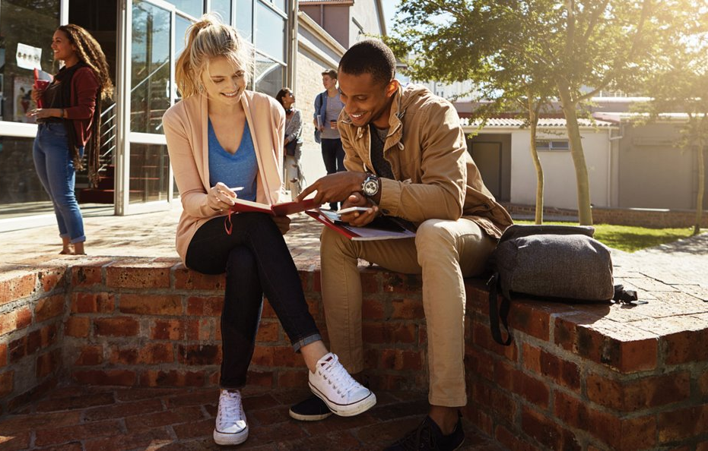
eTutors
available
by subject,
not courses
They are subject experts and have received tutor training.
Tutors are shared among the participating schools.

Slide 10
Subjects may include:
Math
Physics
Statistics
Writing
Algebra
Anatomy & Physiology
Astronomy
Biology
Calculus
Chemistry
Computer Science
Physics
Statistics
Writing

Slide 11
Flexible scheduling
eTutoring tutors work
flexible schedules
seven days per week
Subjects vary
Hours and specific subjects may vary based on the tutor’s availability

Slide 12
Writing reviews for assignments
and papers:
Math
Physics
Statistics
Writing
Upload assignments and reviewers will return suggestions for improvements.
Can assist at any stage of the writing process.
Address common issues in college-level
writing assignments.
Not editing or proofreading.

Slide 13
Patti Grimes
OhioLINK eTutoring Collaborative
614-292-0675 | pgrimes@ohiolink.edu

Slide 14
Set up your account today!
etutoring.ohiolink.edu

